Slide 1
HDW
Project Kleutghen
Kristina Kleutghen, Art History & Archaeology
Haley Harris 2022
Gloria Jin 2023
Lingran Zhang 2021

Slide 2
Output/Goals and Guiding Principles
[KK Adapt milestones/outputs from next slide]
KK Add in how place names, place name counts, object and mapping data will be used in research for this chapter (with implications for other chapters)
Object-centered
Digital Art History
Bilingual (English/Chinese)
Open Access images
Mapping and Data Visualization
Open Source tools
Open Scholarship
Notes:
Place name mentions change in frequency over time, track any patterns between certain places are never mentioned on certain objects

Slide 3
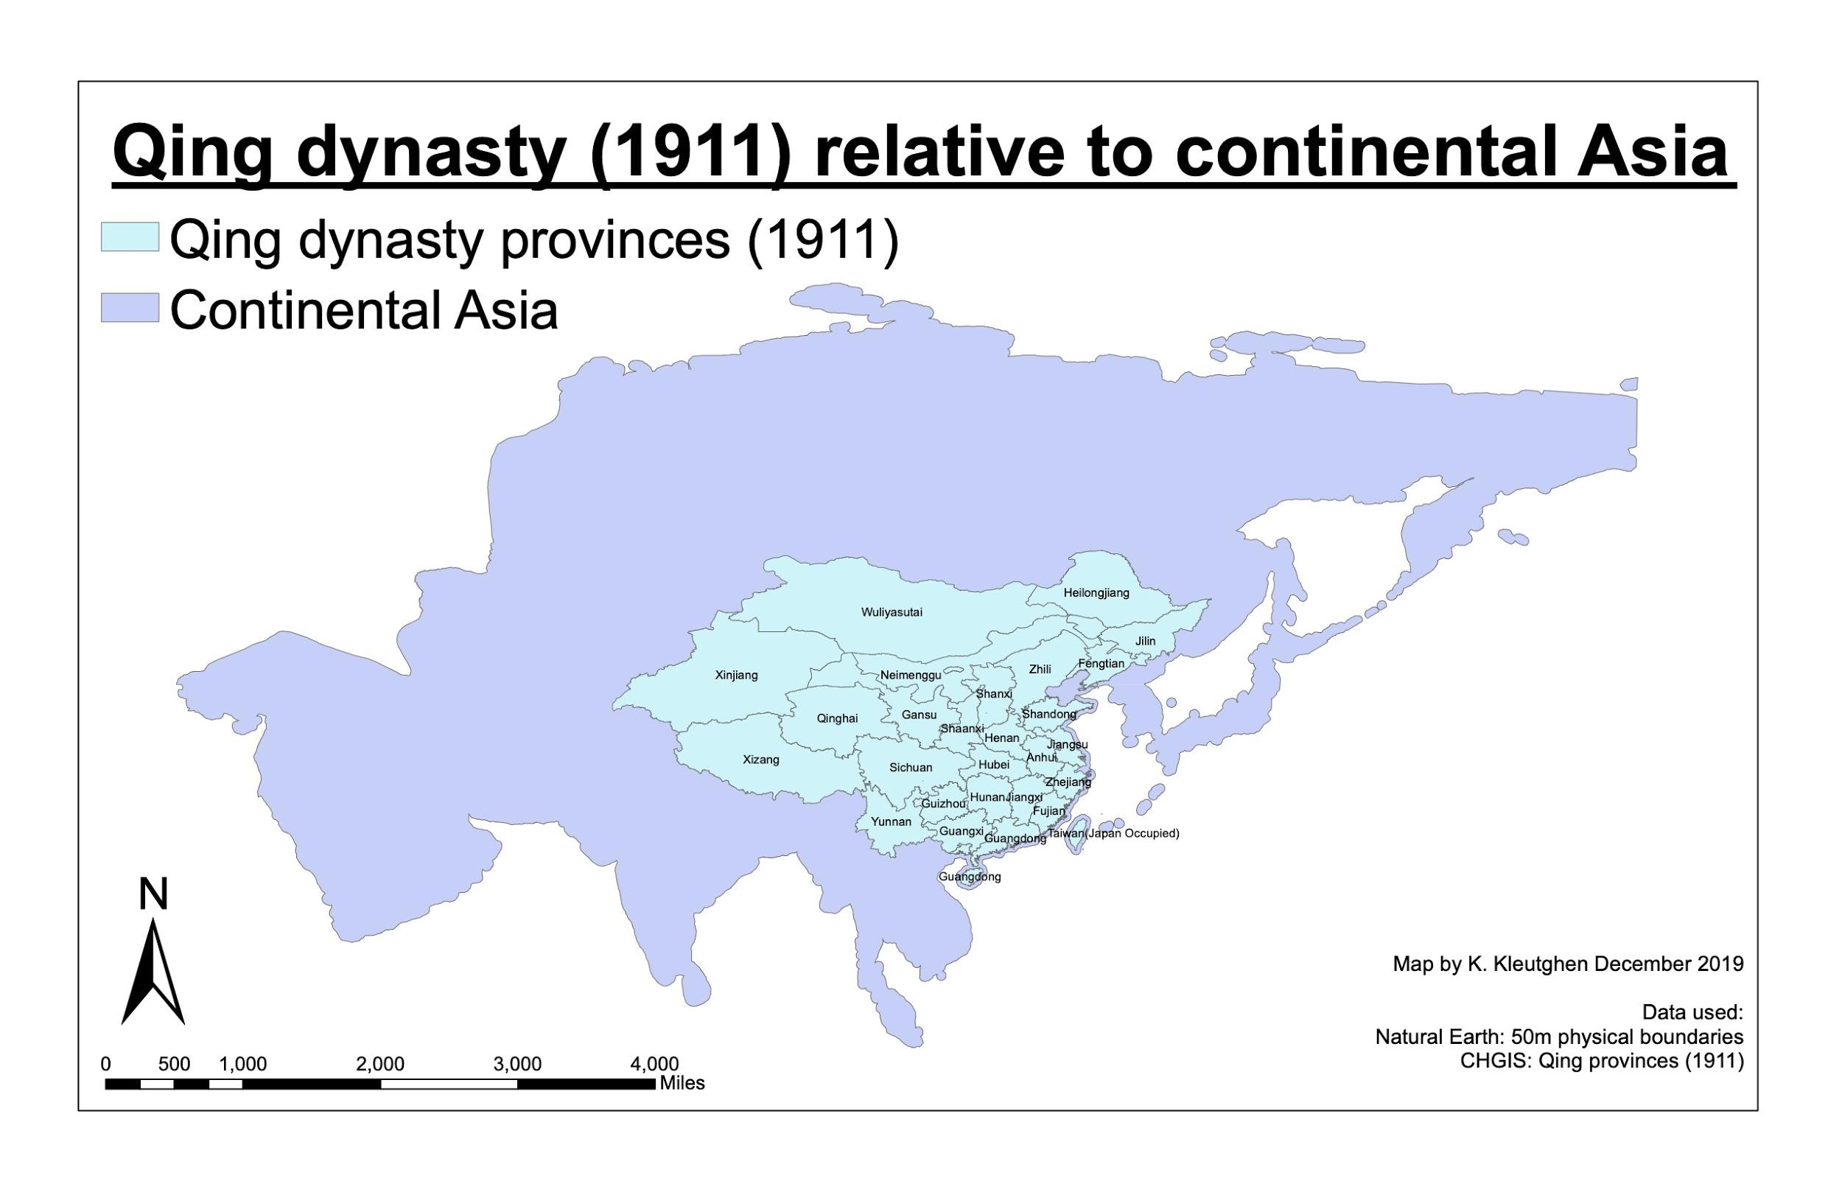
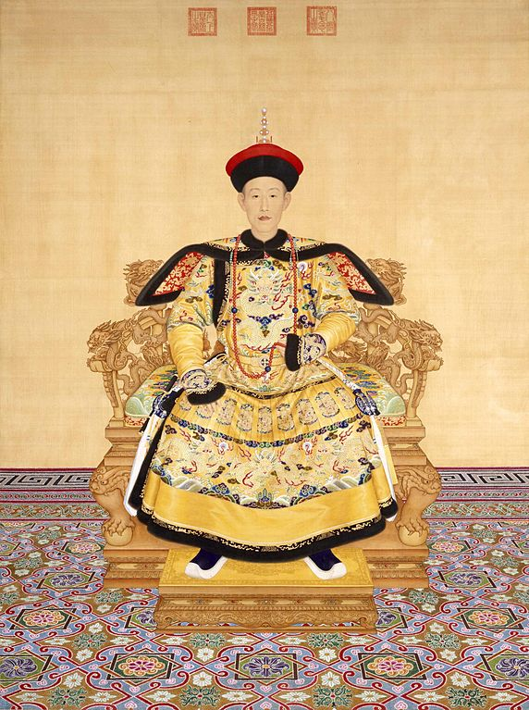
Qing Dynasty (1644-1911) and the Qianlong emperor (r. 1736-1795)

Slide 4
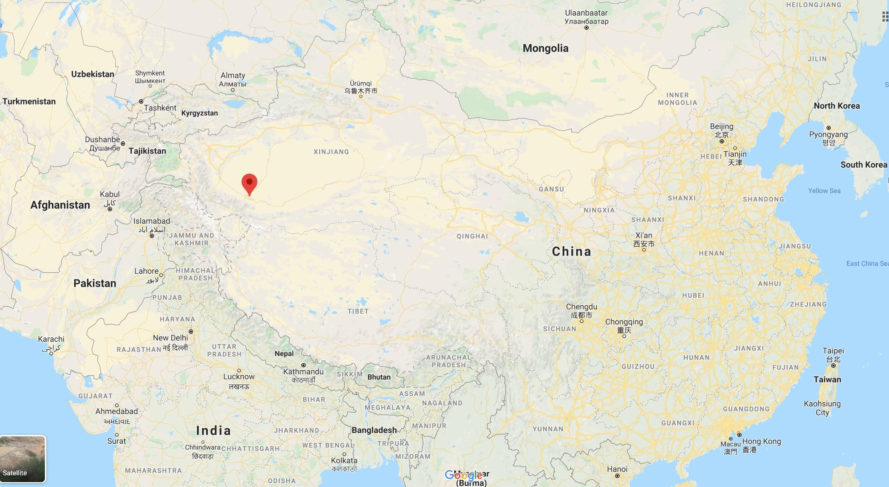
Nephrite jade mined in Khotan, 4000km from Beijing

Slide 5
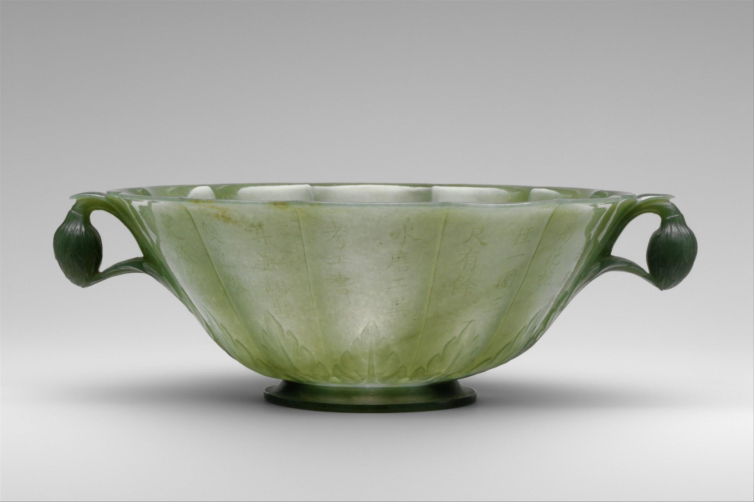
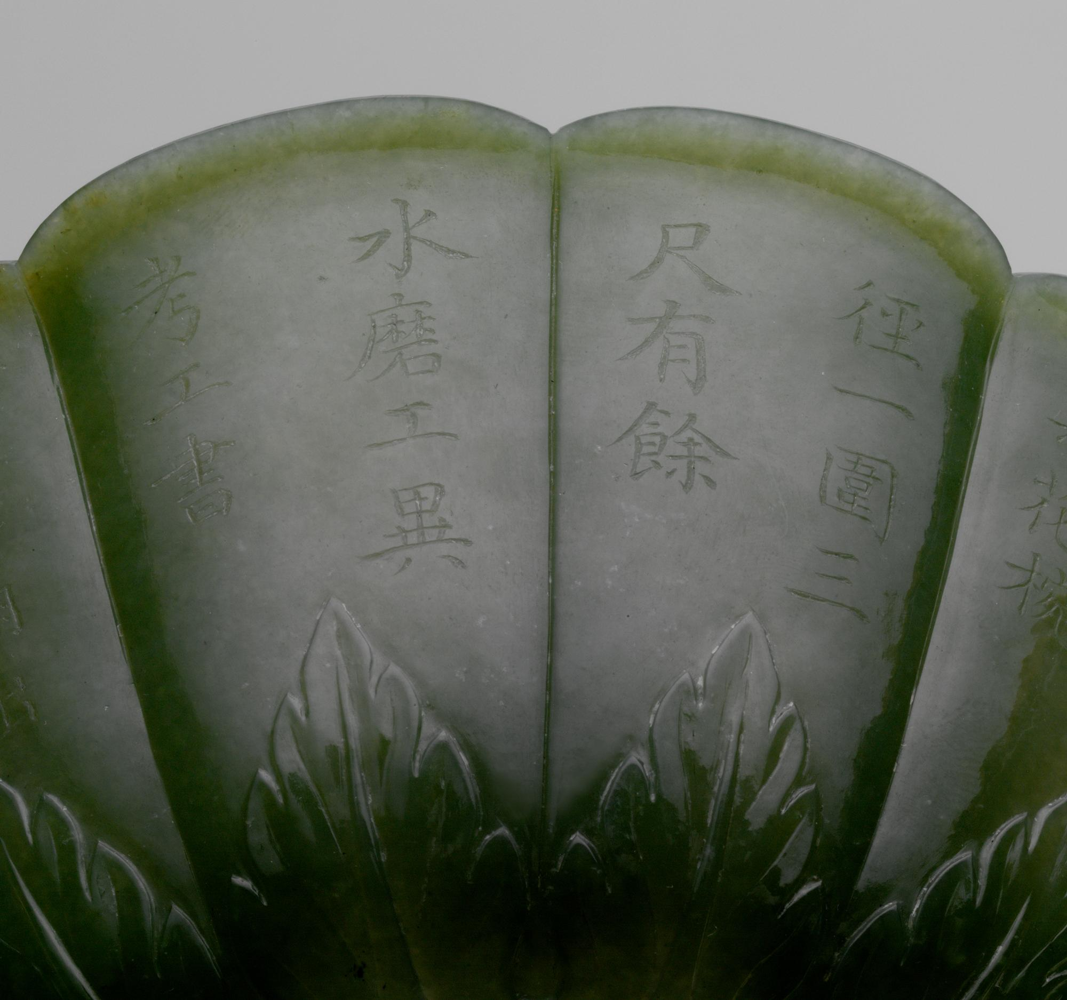
The Qianlong Emperor’s “Hindustan” Jades
(Qing empire, c. 1760-1800)
Mughal floral-form jade bowl (India, 1526-1858)
Collected by Qianlong emperor c. 1760-1770
Incised with Qianlong’s poem in Chinese dated 1770

Slide 6
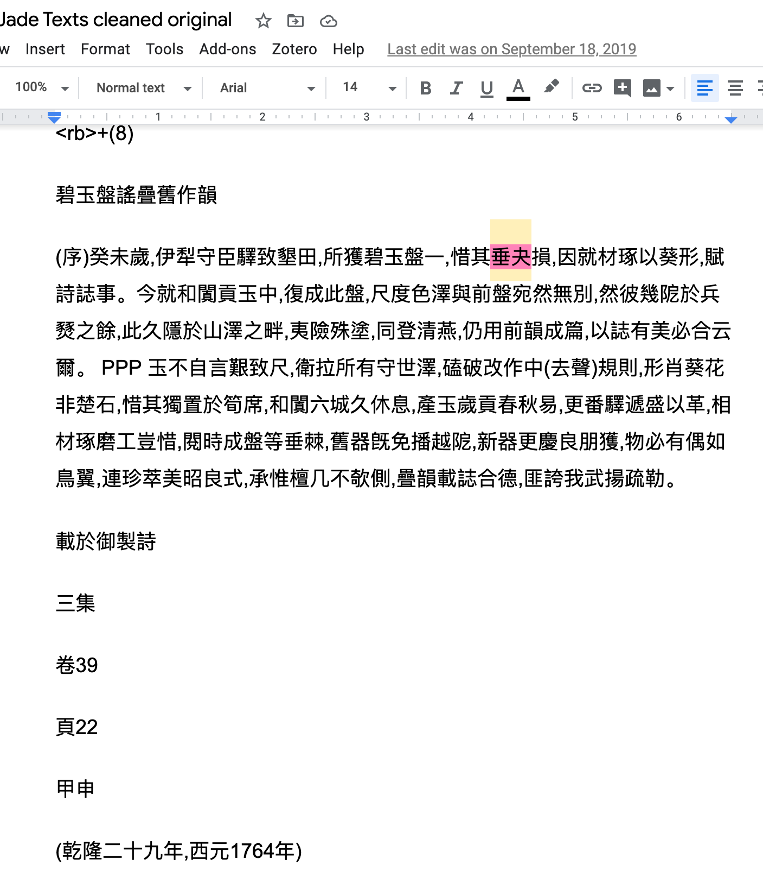
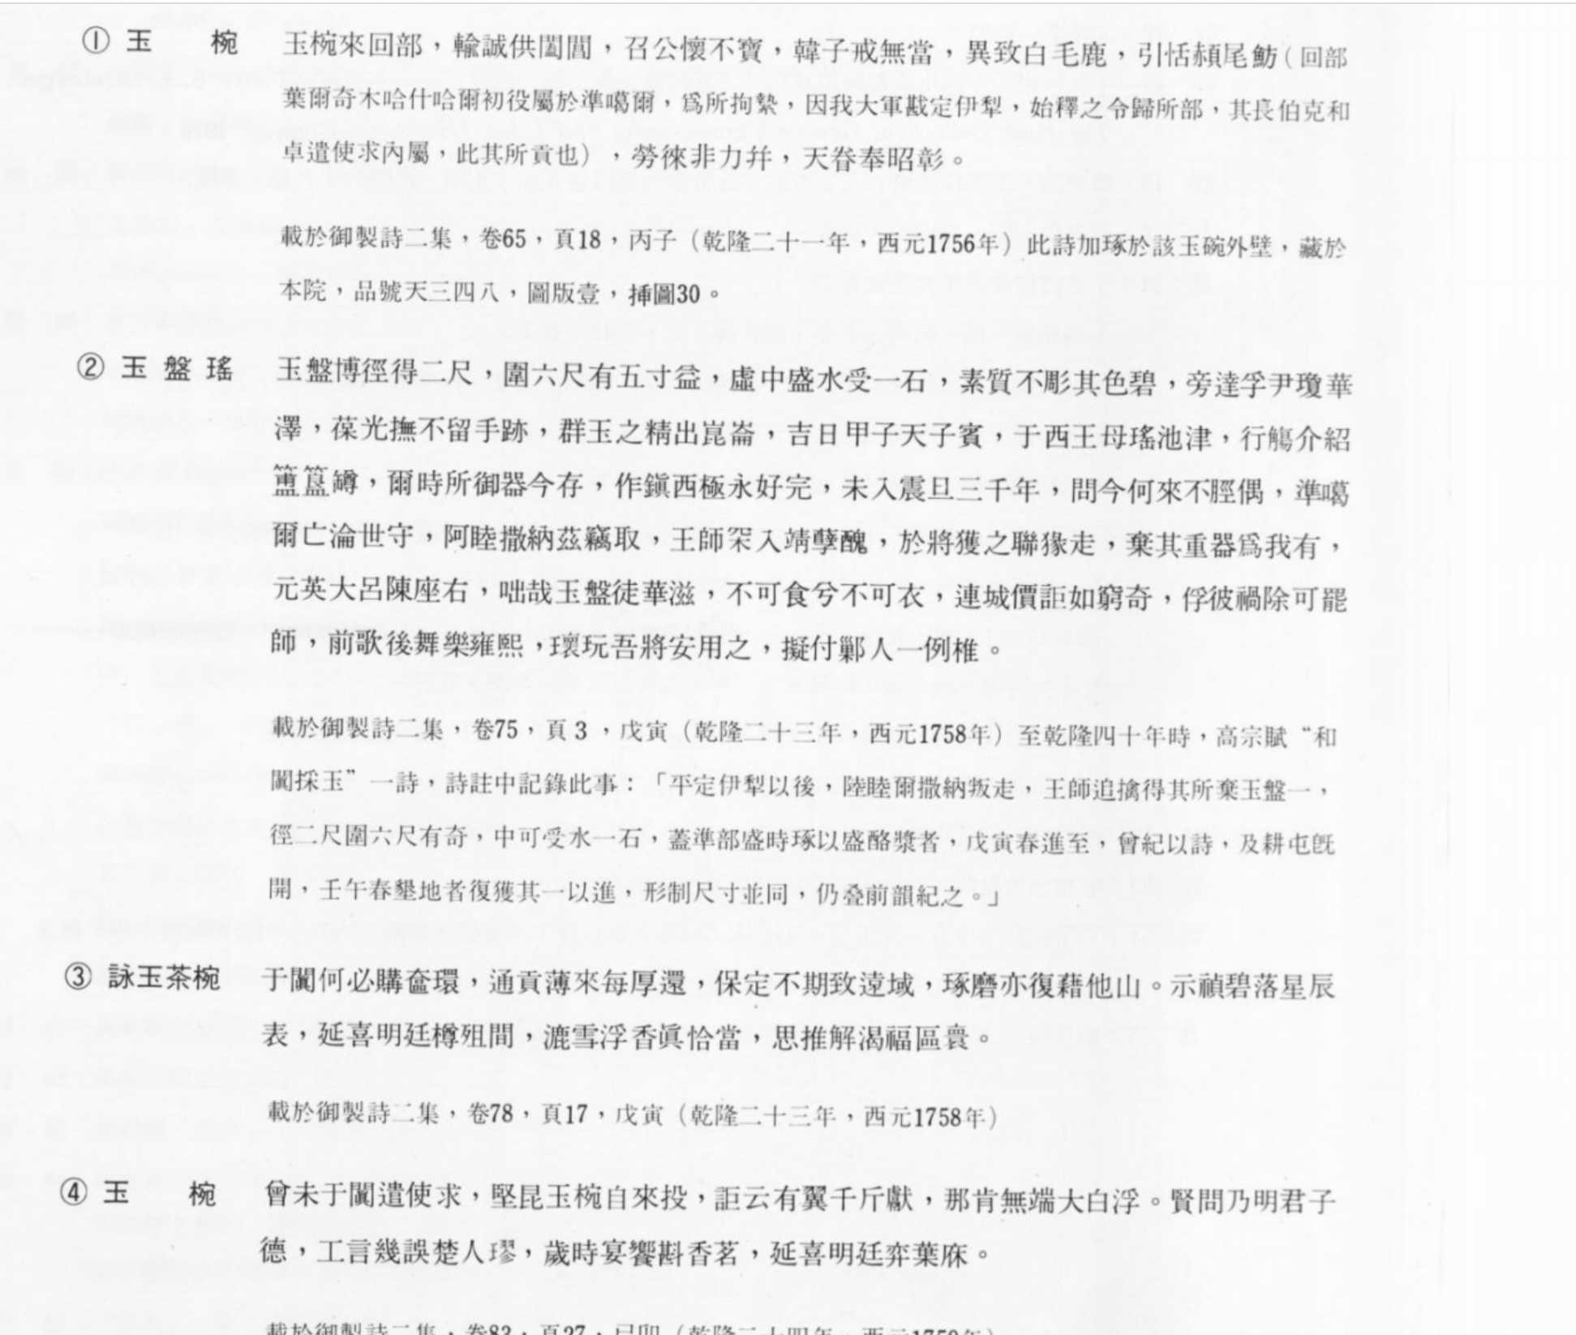
Fall 2019
Notes:
Primary source: museum catalog NPMT+DPM
PDF>Doc>Excel

Slide 7
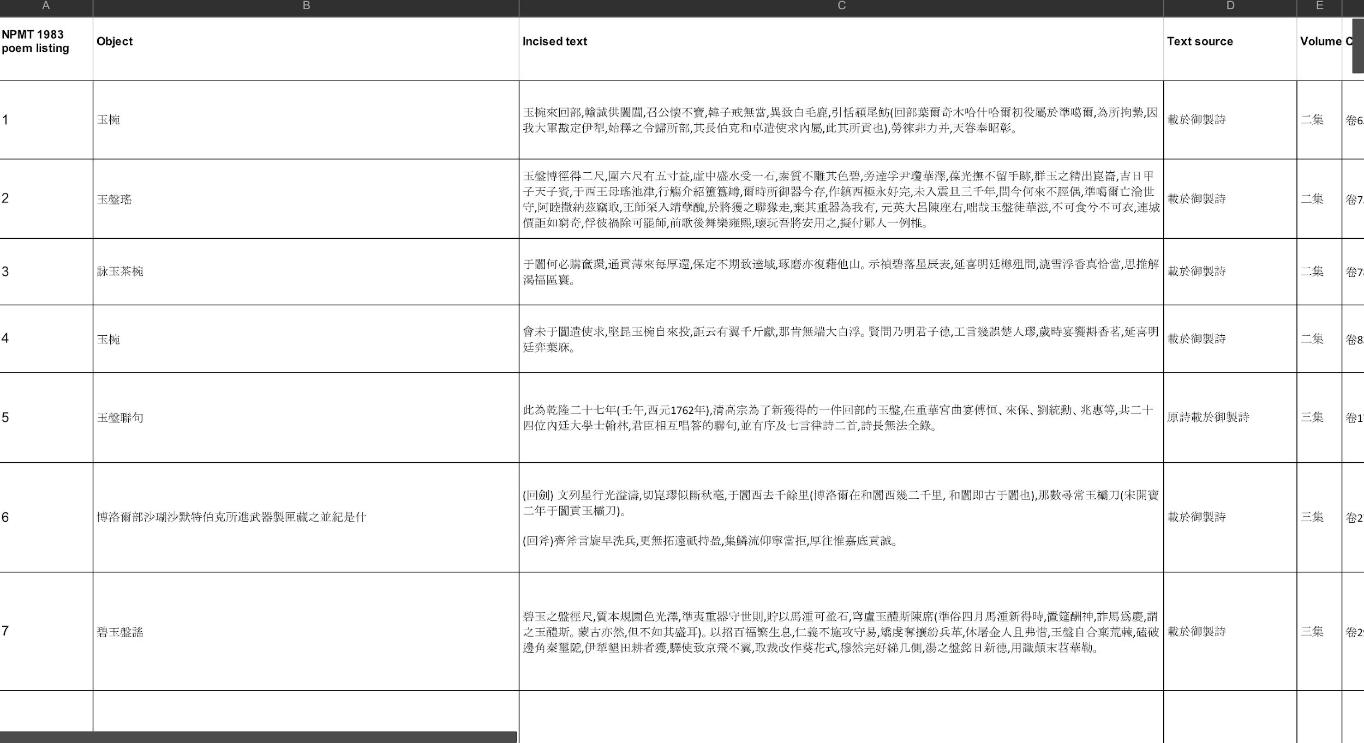

Slide 8
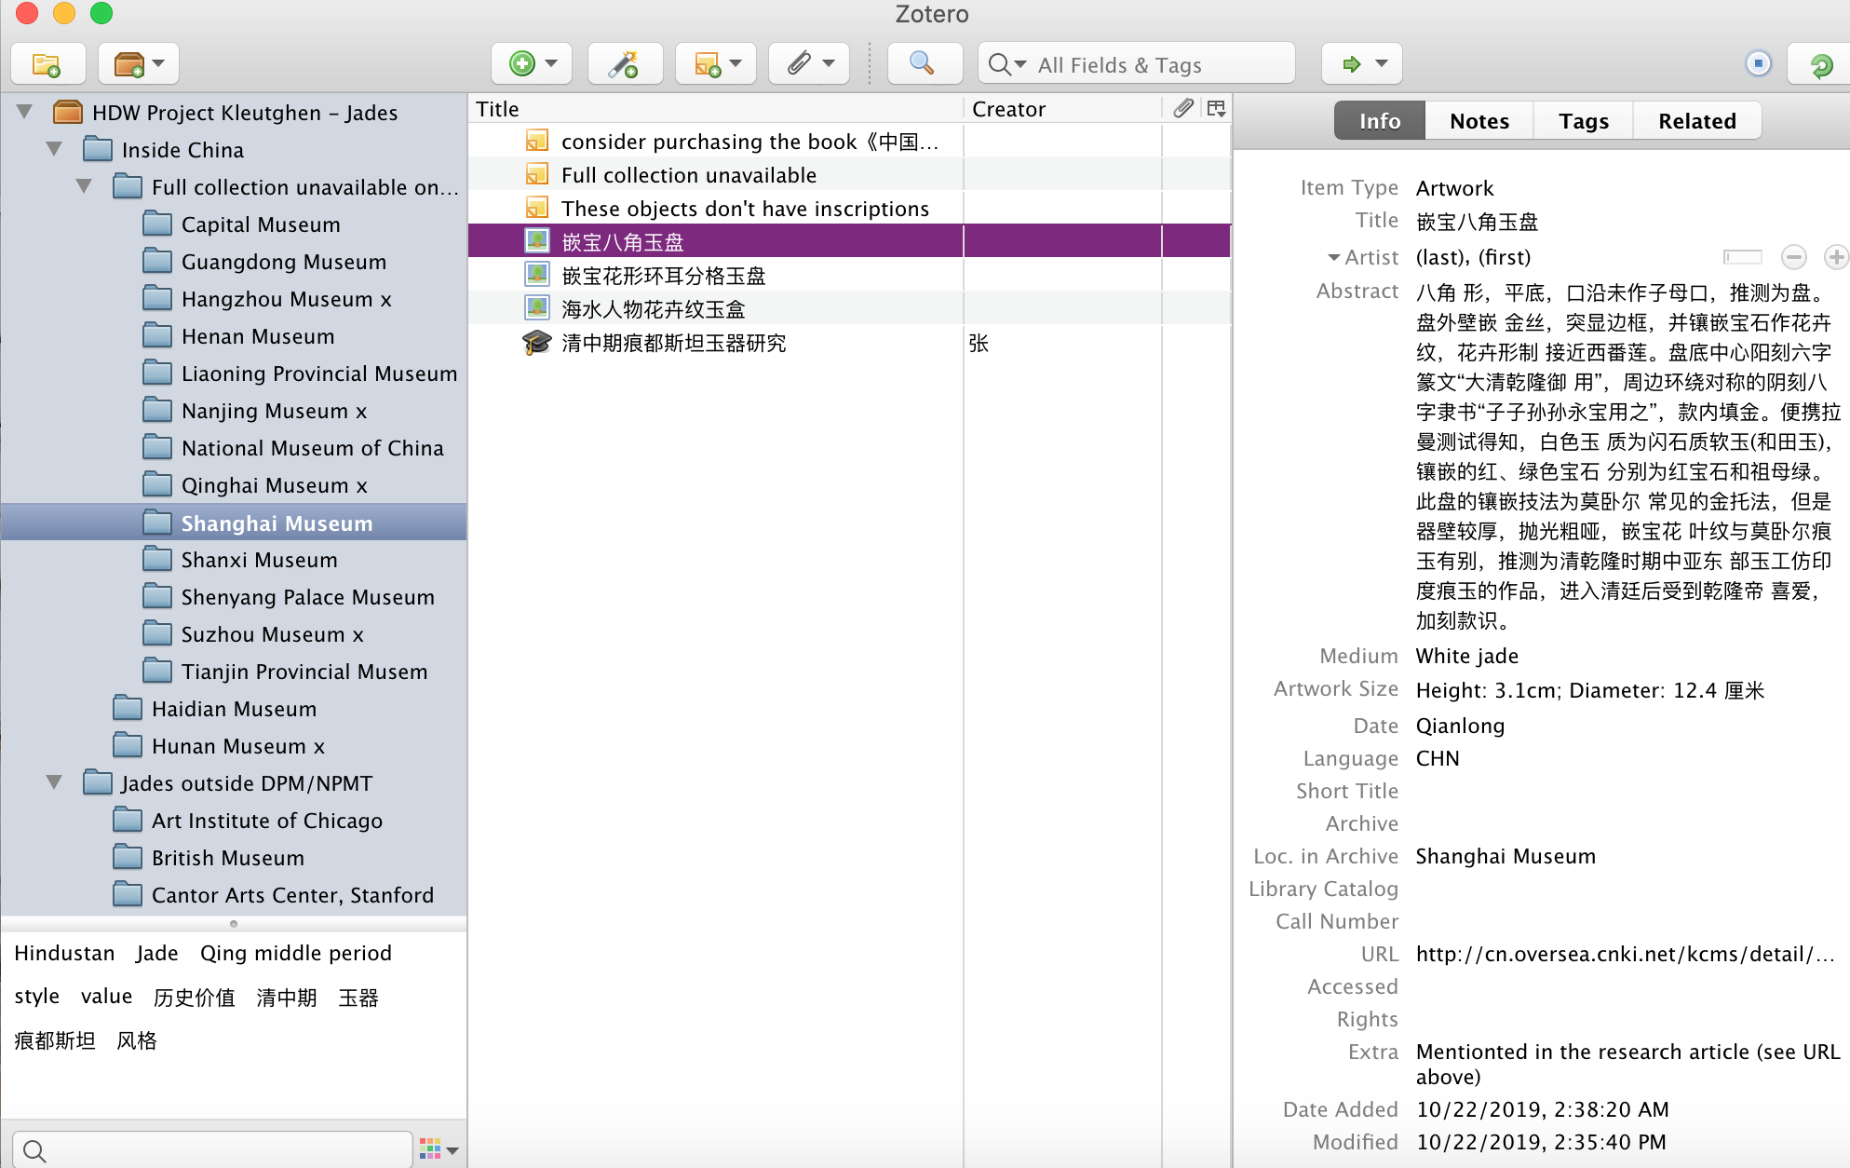

Slide 9
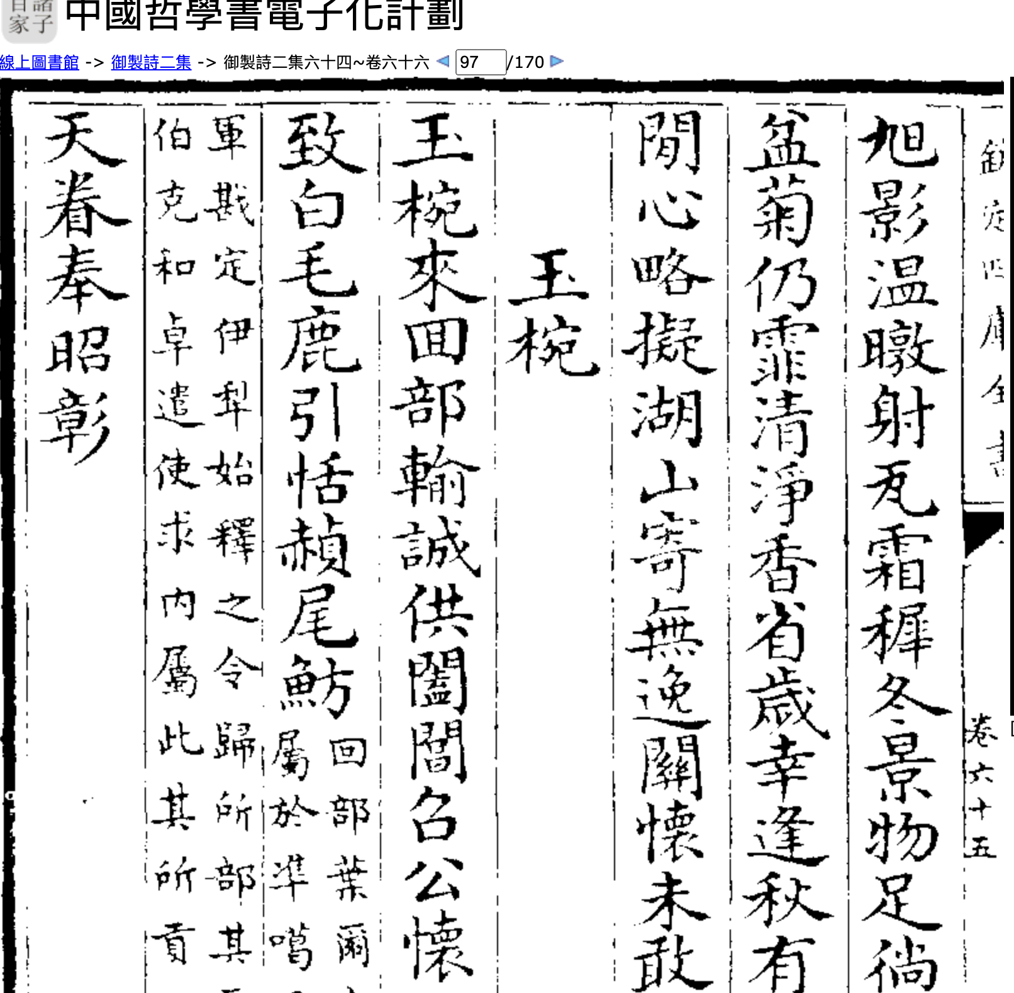
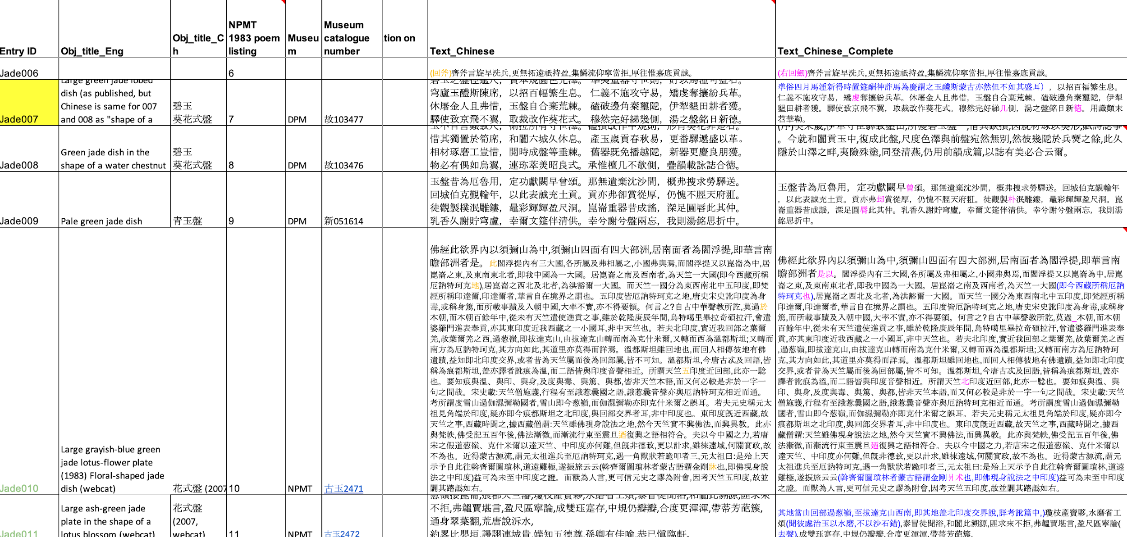
Summer 2020
Notes:
Inablity of OCR

Slide 10
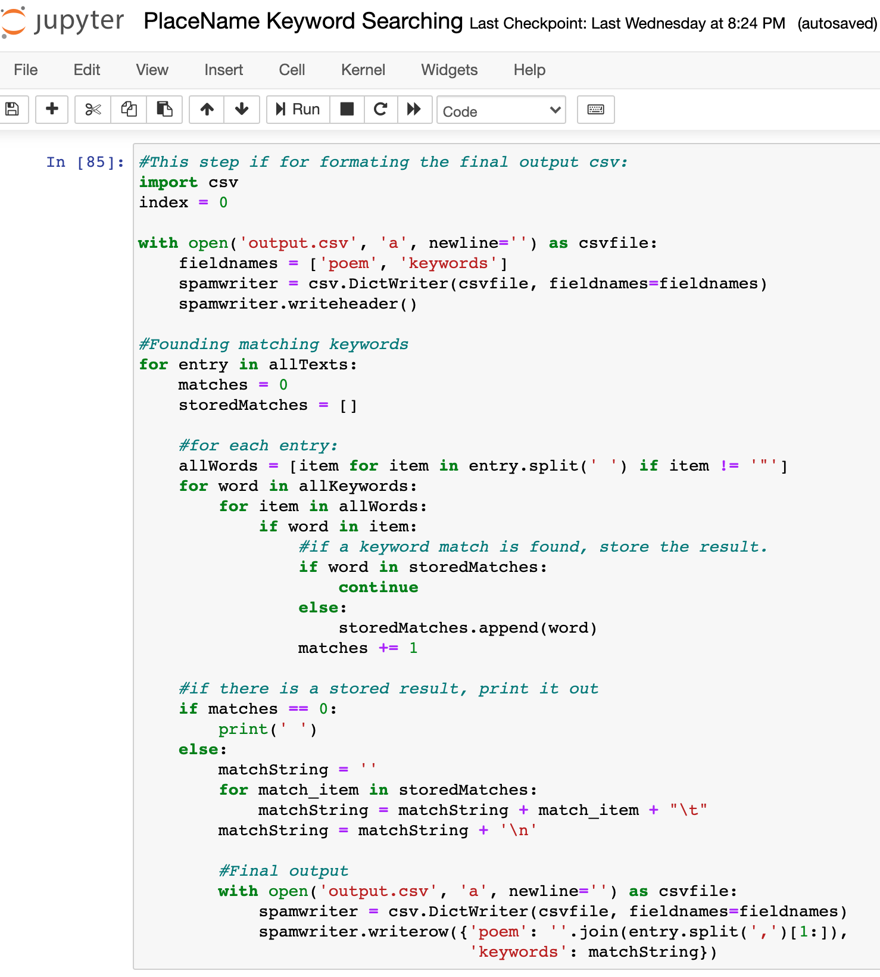
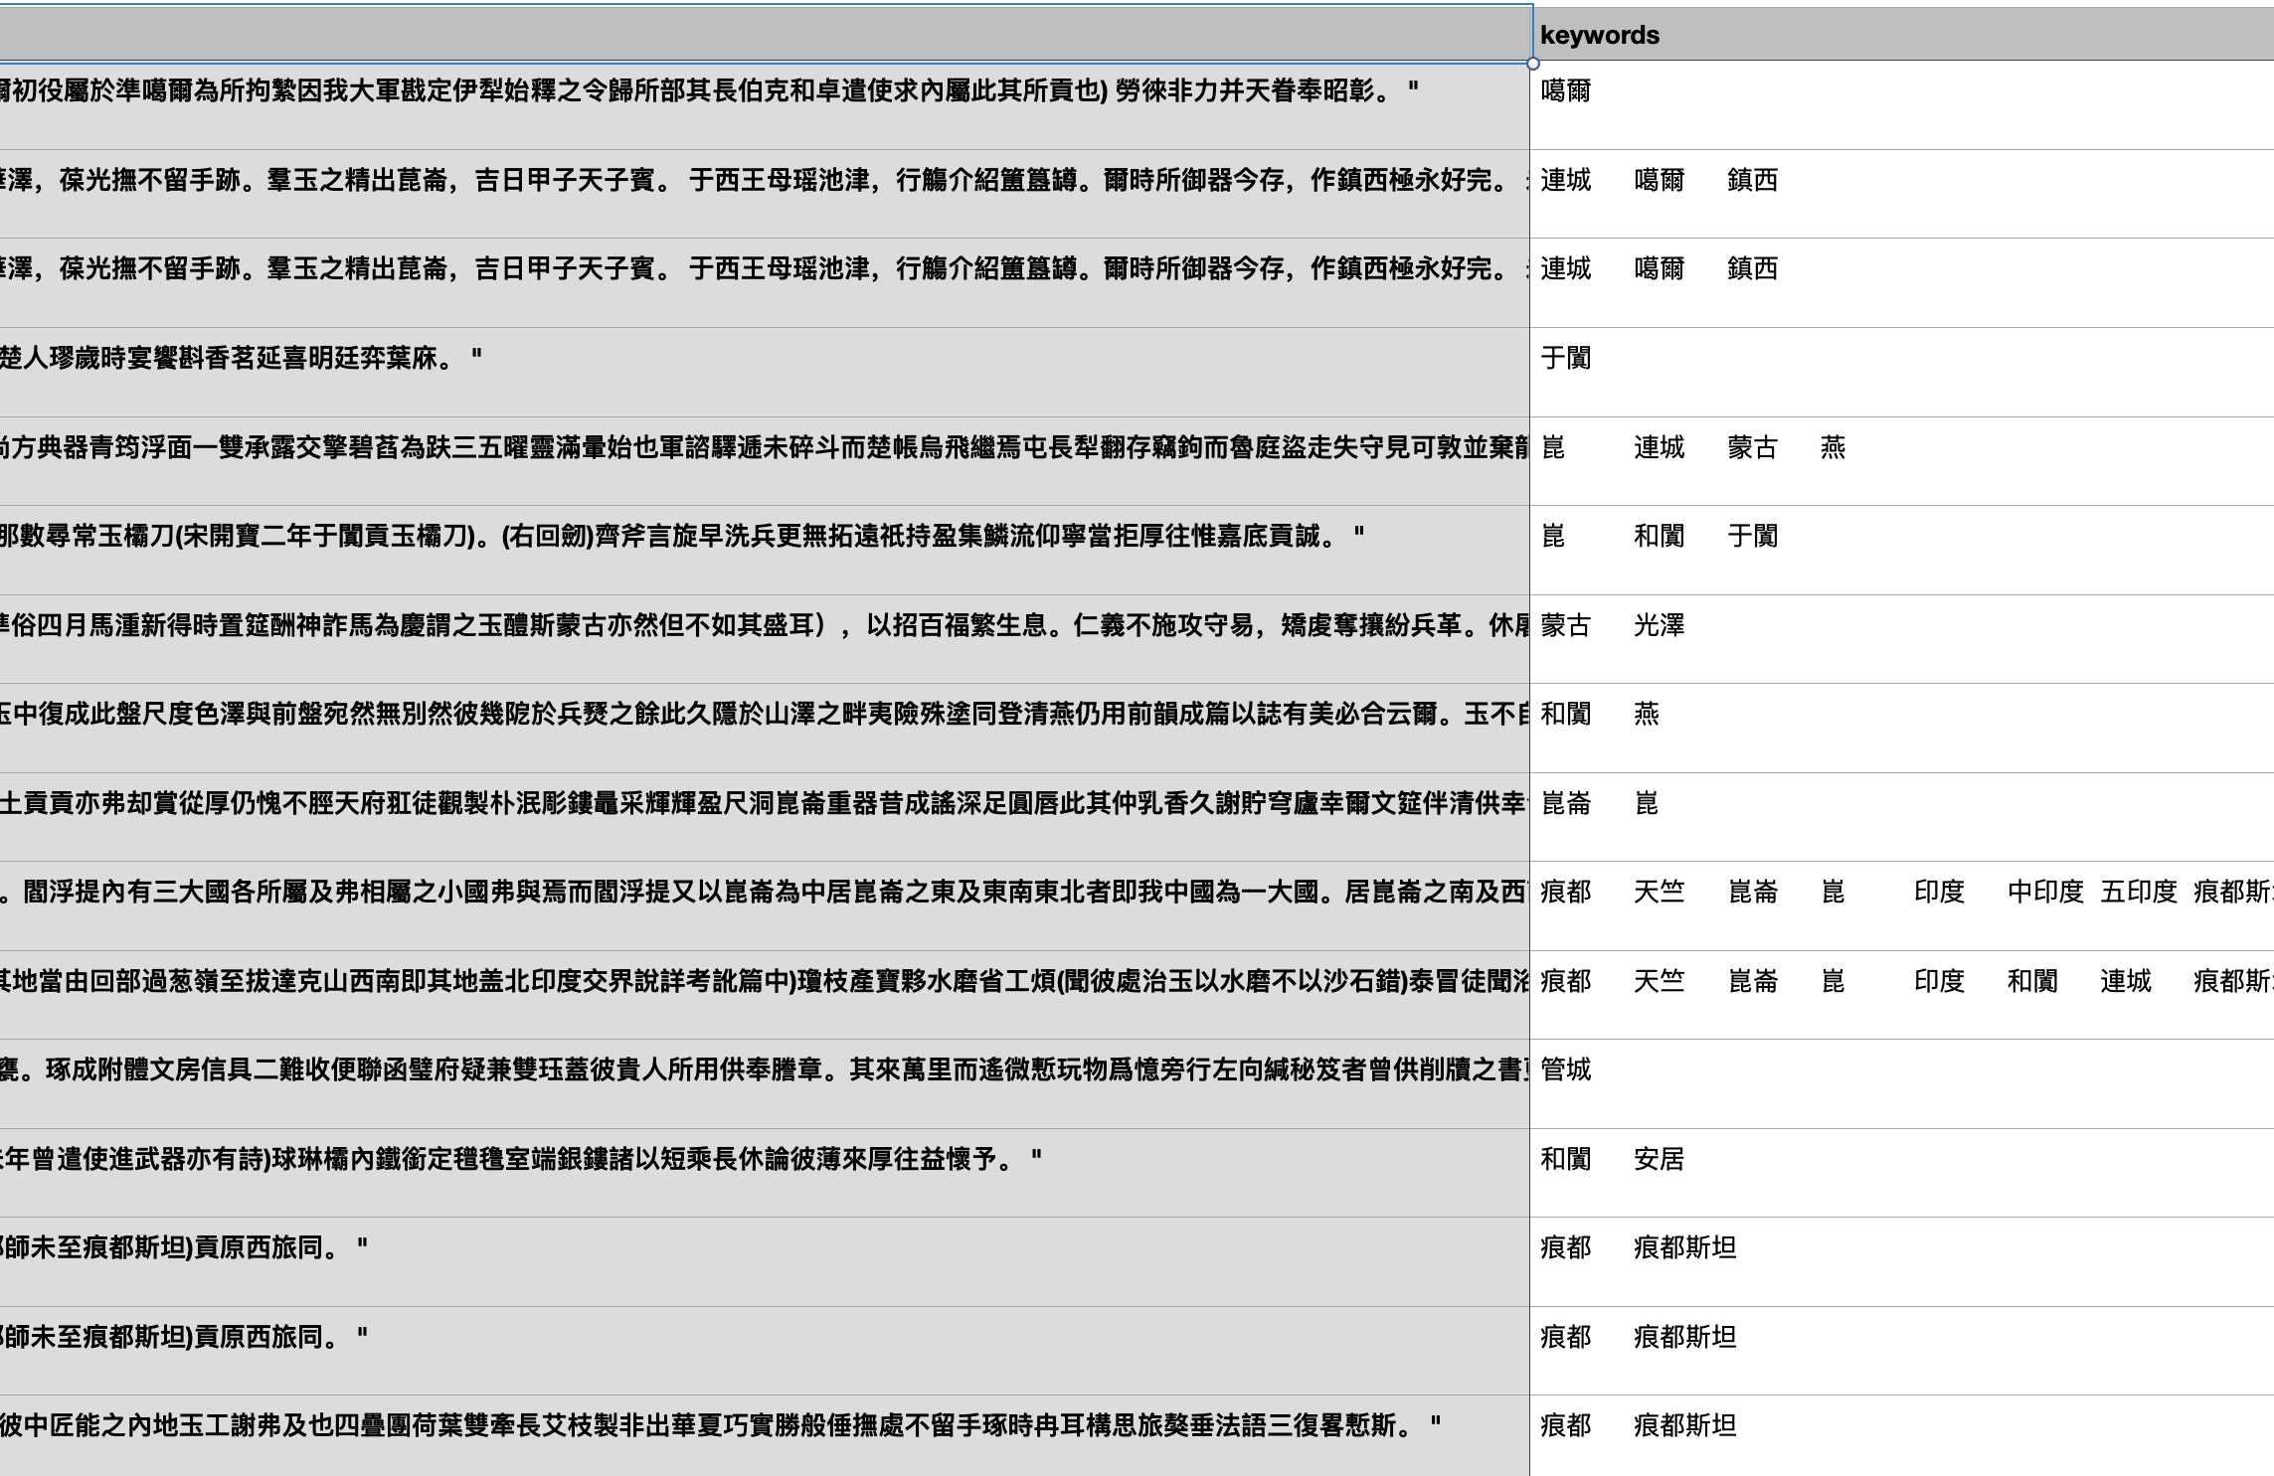

Slide 11
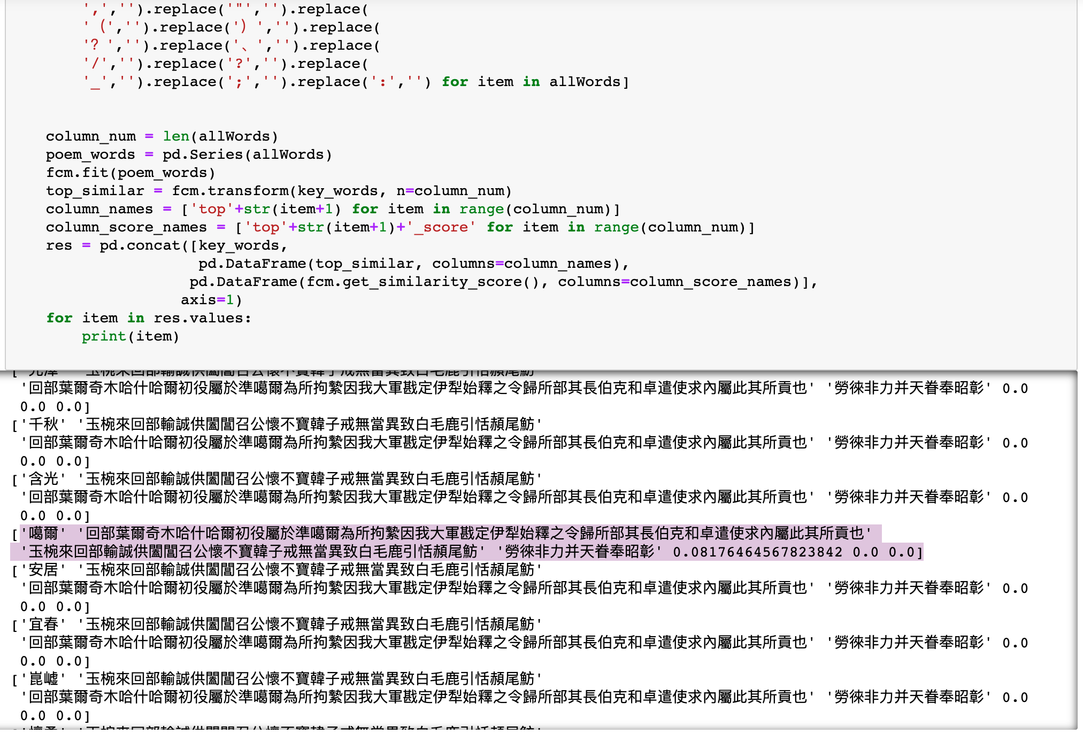
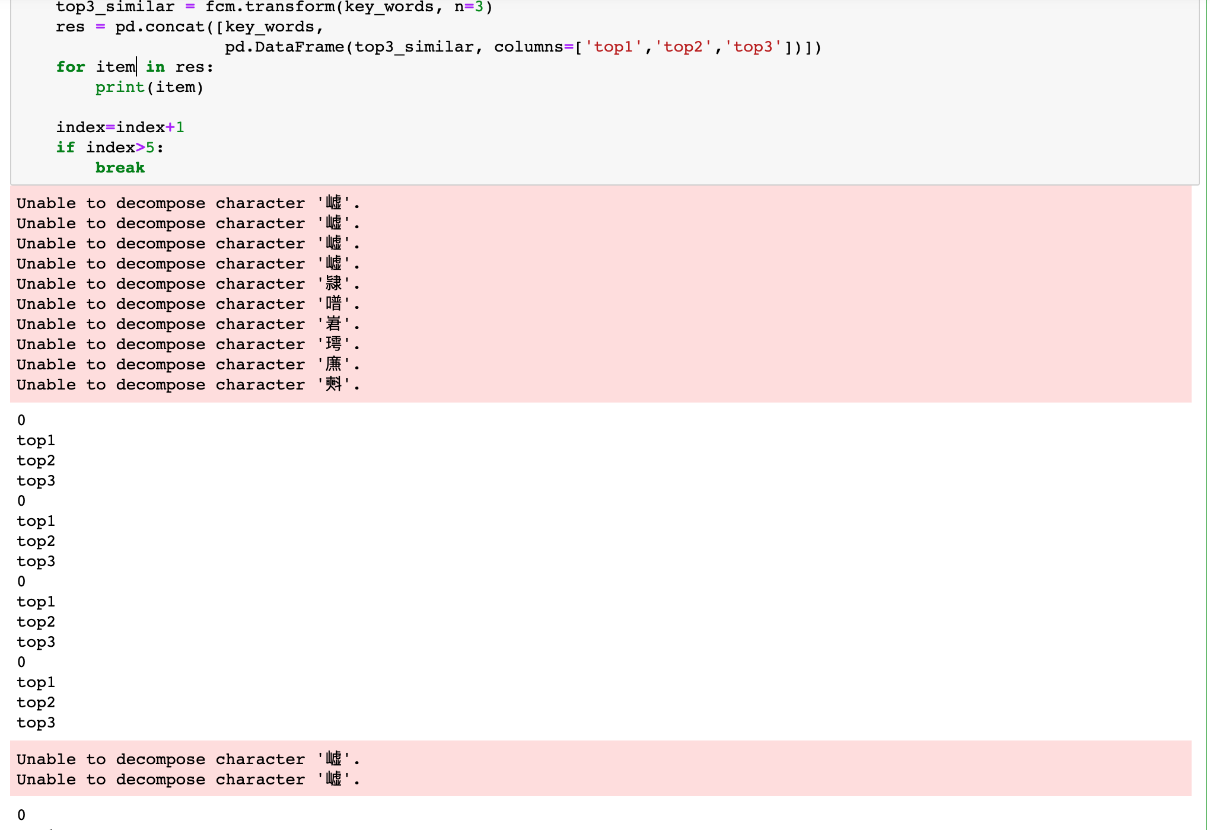
FuzzyChinese
“昆仑，崑崙，昆侖，菎崙”

Slide 12
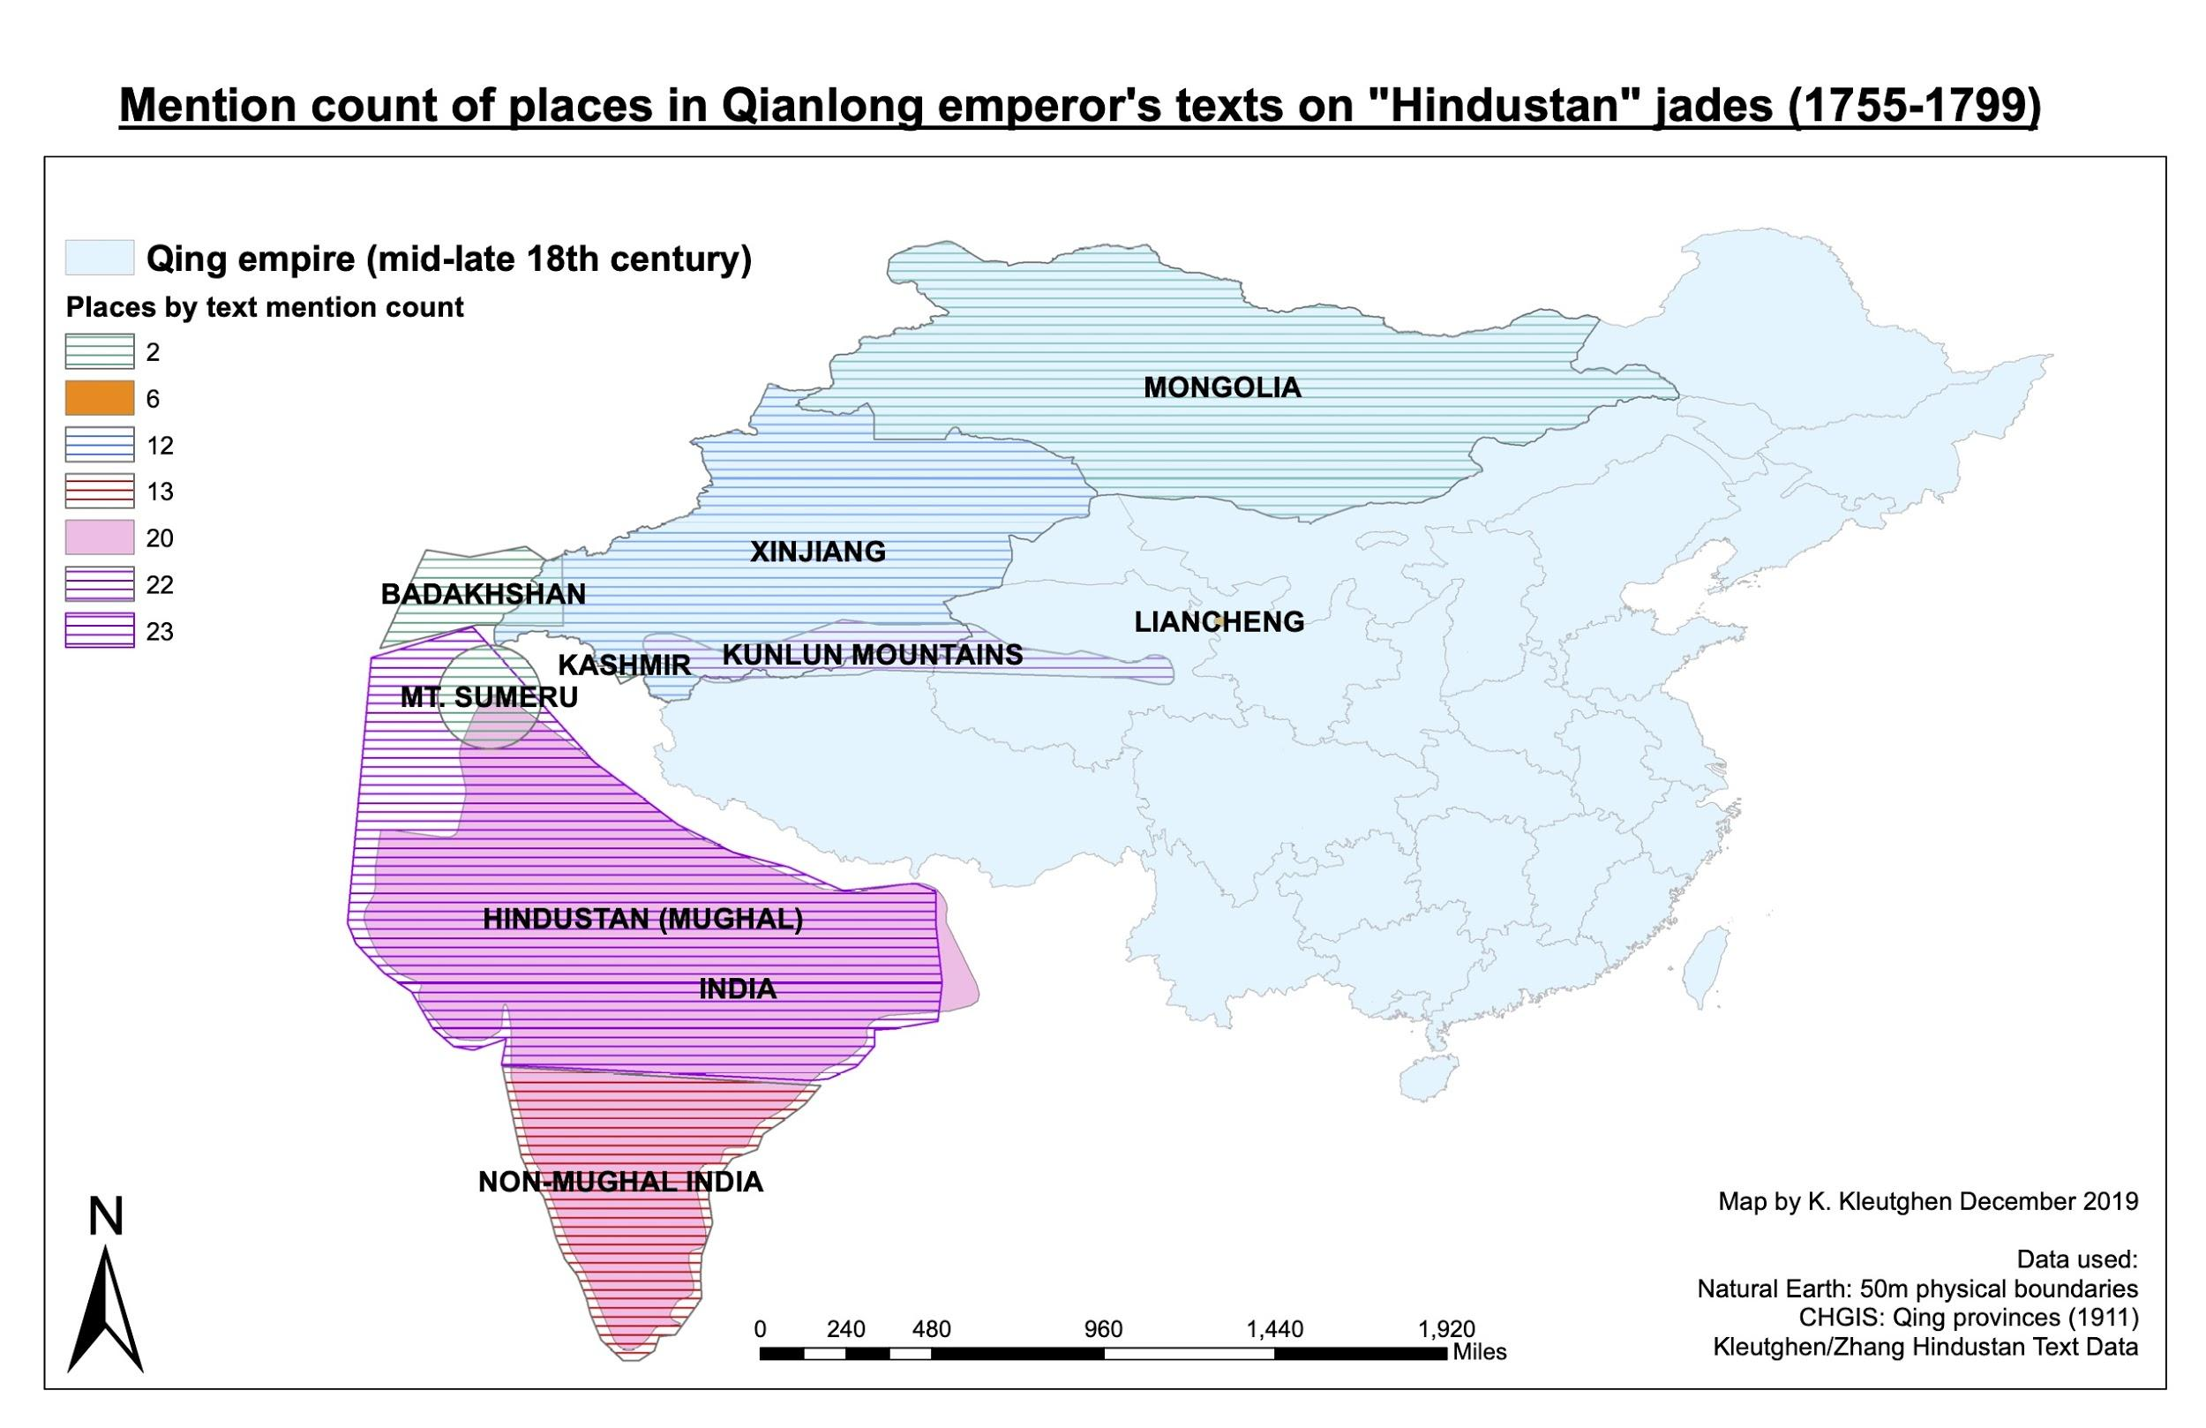
Why QGIS/Leaflet rather than ArcGIS/Online
ArcGIS benefits:
Comprehensive
Widely-used in industry
ArcGIS limits:
Difficult to learn, PC-only
Closed source and costly
ArcGIS Online benefits:
Simple to learn and use
WUSTL-supported
Browser-based, cross-platform
ArcGIS Online limits:
Low popup/image support
Variable historical mapping
Not mobile-friendly
Restrictive formatting
Closed source and costly

Slide 13
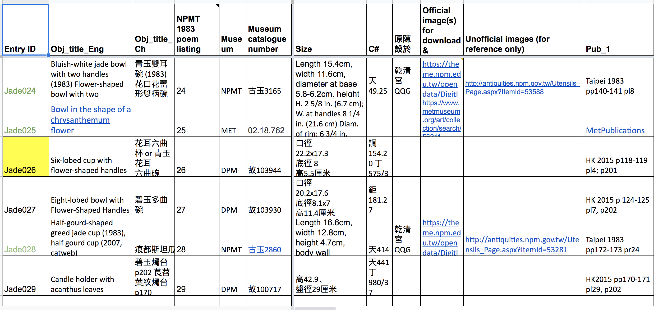
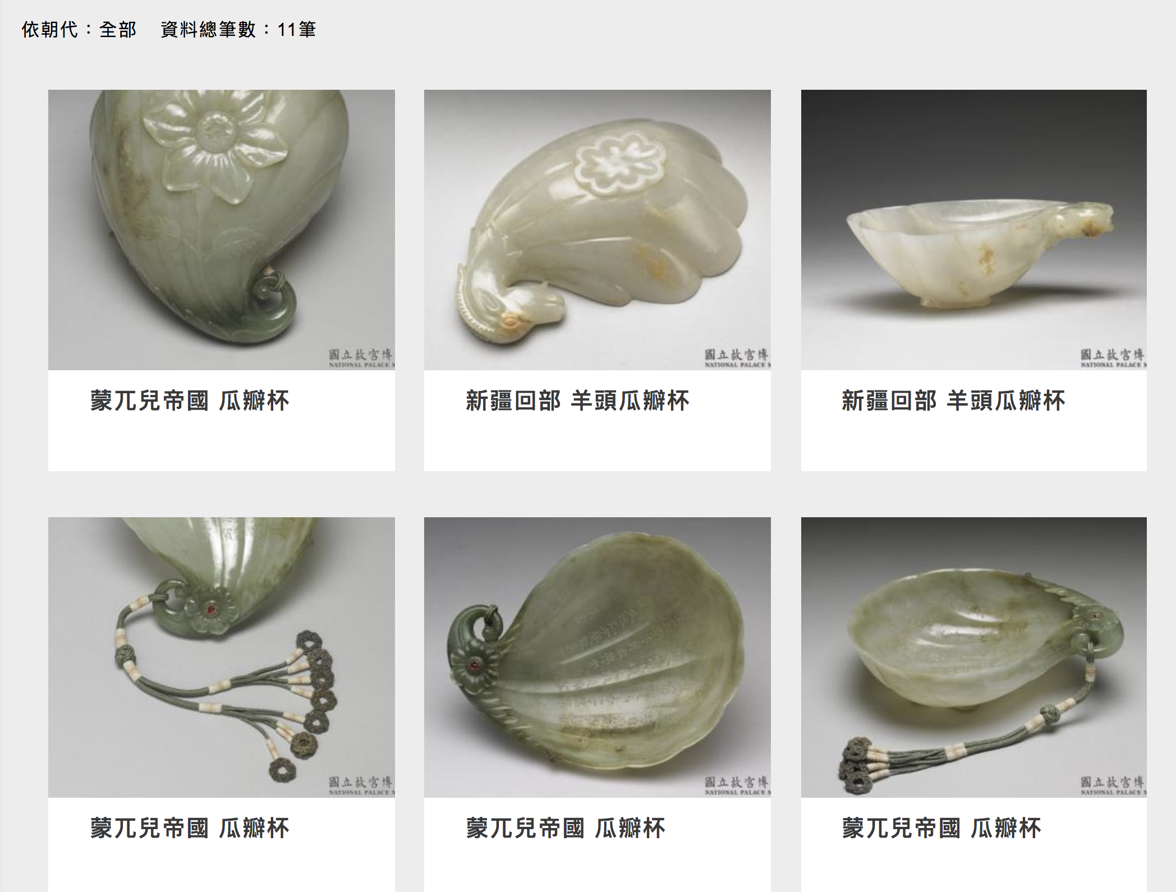

Expand the Spreadsheet
Object rather than images
Bilingual aspect

Slide 14
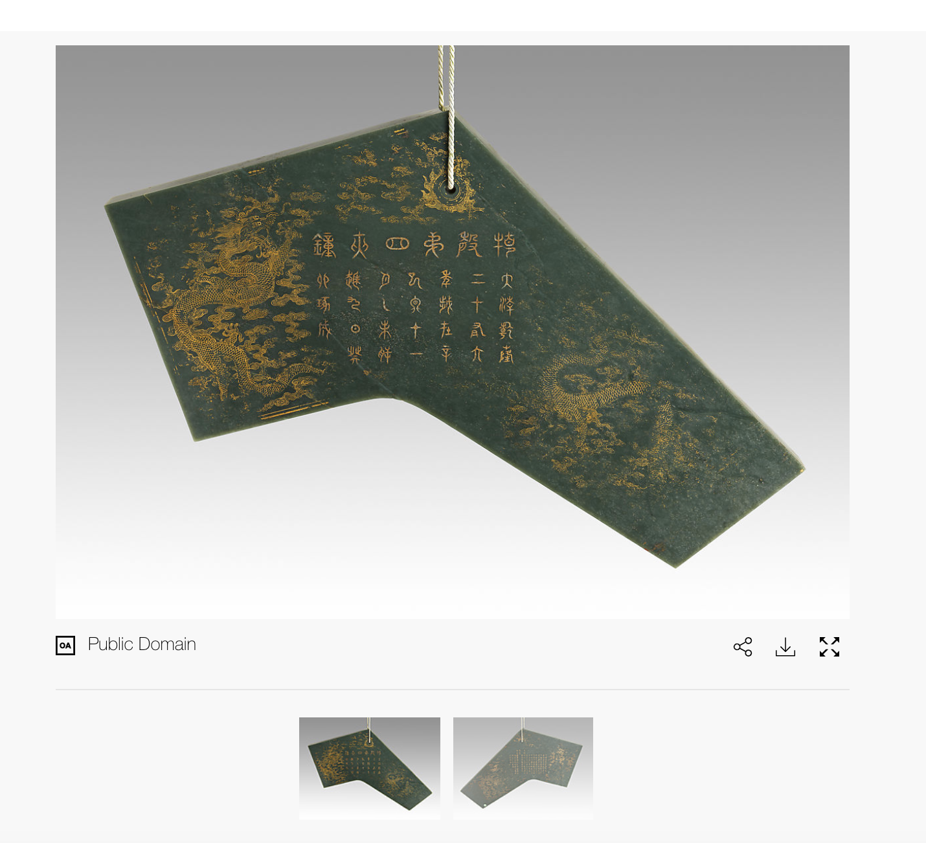
Digital Art History/ Open Access Images
A Guiding Principle for Digital Art History: Images are not Objects
Open Access/ Image Rights
Metadata Standards
VRA Core & Dublin Core
Cataloguing Cultural Objects (CCO)
“Digitization does not equal access.” - Murtha Baca (Introduction to Metadata)
“Qing,” mid 18th C (inscription), Metropolitan Museum of Art, New York City

Slide 15
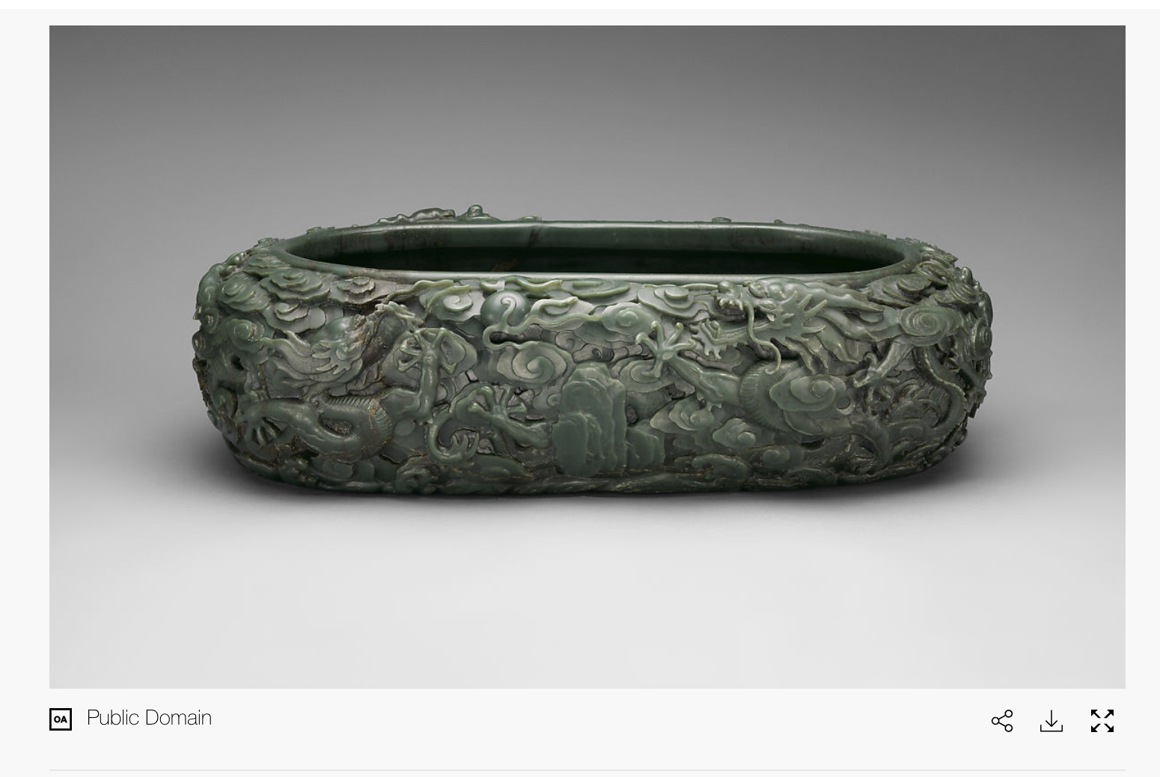
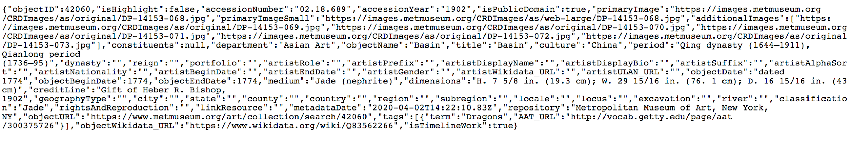
Digital Art History/ Open Access Images
Open Access API :
Ex: MET + V&A
Open Access Image
Use of JSONs
Compatibility
Cleaning/ Organizing Data
Consistency
“Green Khotanese nephrite basin”, 1774 (inscription), Metropolitan Museum of Art, New York City
Corresponding JSON file

Slide 16
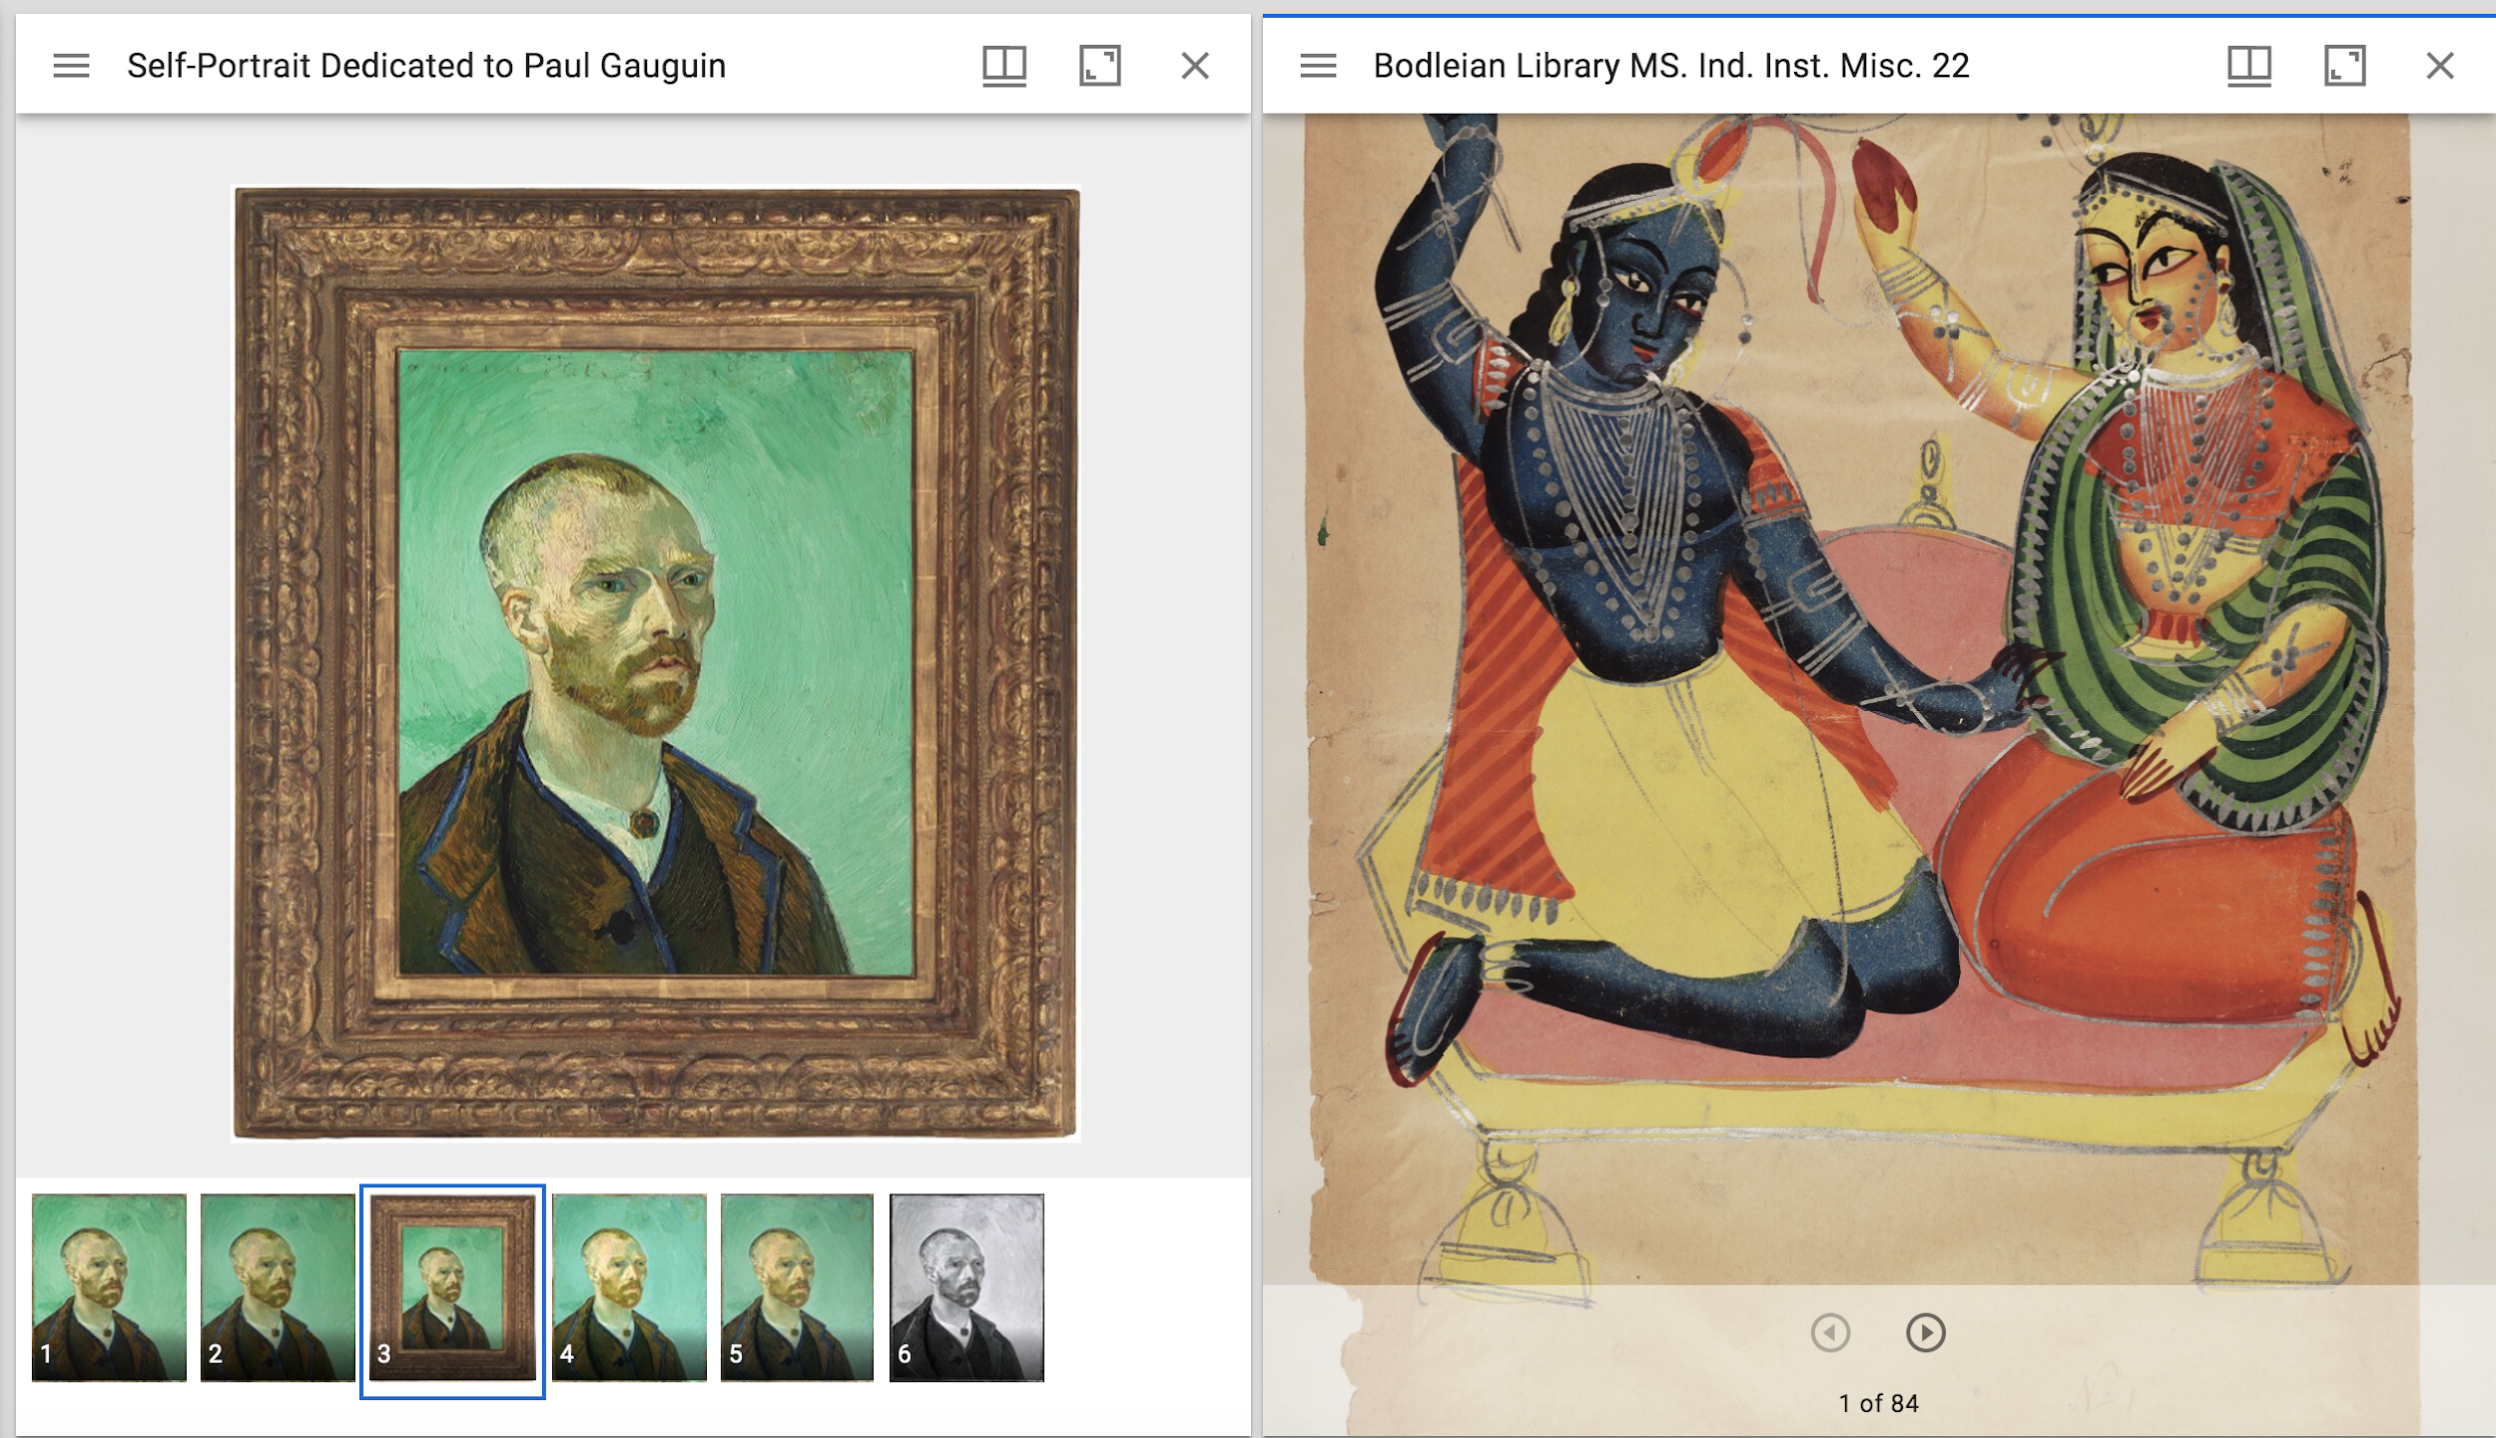
Digital Art History/ Open Access Images
Further Goals/ Areas for Exploration:
IIIF Viewer / Presentation API
Ex. IIIF Tool: Mirador

Slide 17
Next Steps
Notes:
Last slide for 2020 summer presentation

Slide 19
Project Components, Tools, and Workflow
Object-centered CSV coordinating extant/lost objects with related texts, collection locations, images, publications, Imperial Workshop Archives, etc.
Google Sheets and GitHub to support synchronous and asynchronous collaboration across projects, tasks, team members, and time zones both now and in the future
Object-centered CSV coordinating/counting places for use in maps
Google Sheets, OpenRefine, Python
Data processing for research use
Place counts: which places appear; when; on what objects; in what quantity
quantitative vs. qualitative data
Mapping places demonstrates inter-regional vs. intra-regional interactions
Determine effects of watershed events/years on object production, collection, etc.
Role of decorative arts and material culture in empire expansion and multiethnic growth

Slide 20
Project Components, Tools, and Workflow
Data visualization: maps and [form yet to be determined]
Maps: QGIS and China Historical GIS (basemaps); Leaflet (mobile-friendly interactive maps)
Visualization: Gephi? (TBD - suggestions welcome)
IIIF viewer to compare/annotate/zoom Open Access images across collections
OA institutions for Image API ; Mirador (or Universal Viewer) as Presentation API
IIIF plugin for Leaflet to include images in map pop-ups
Website to present data; data visualizations in maps, etc.; IIIF viewer
Static website built with Jekyll and GitHub Pages

